Slide 1

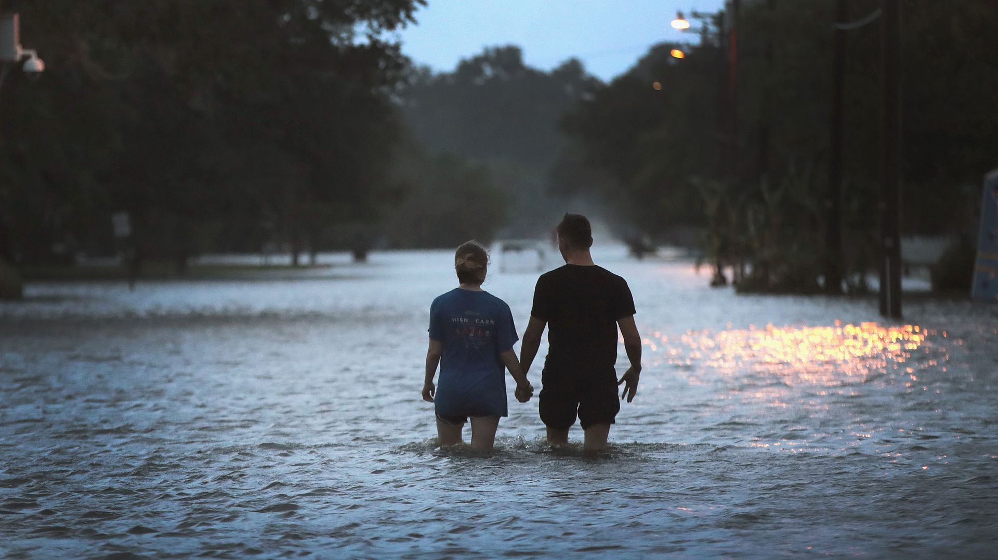

Rareș Onț Radu Lucuț
Tropical Drought

Slide 2
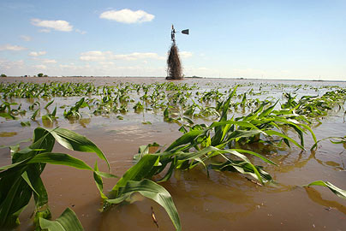

Problem
Very little time to make a decision that can affect your life in flood situations
A lot of jobs depend on an instable agriculture
Local and global economy depends on these areas

Slide 3
Solution
An application that predicts future floods/droughts and offers agricultural recommendations:
Flood/Drought
prediction
Choose better
crops for
your economy
Plan future
irrigations plans

Slide 4



How it works
Evaporative data
Soil moisture
Future water elevation
Terrestrial water
Temp/Rain amount for the last seasons
Deforrestation rate
Agricultural alternatives
Better irrigation
More crops produced
Increasing economy

Slide 5
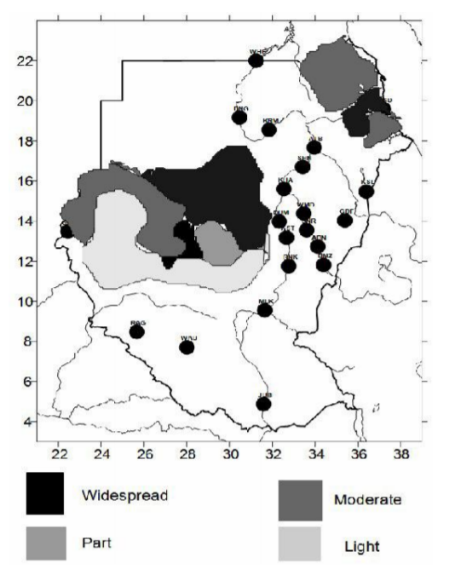
Sudan
In 1913 and 1940, about 1.5 million people were affected by severe droughts. In the 1984, 4.5 million people went hungry.
This year > 350.000 were affected by floods in Sudan that spread diseases and polluted the water.
Drought amount in Sudan
Notes:
Some of the affected people became relief-recipient and less work-oriented.

Slide 6
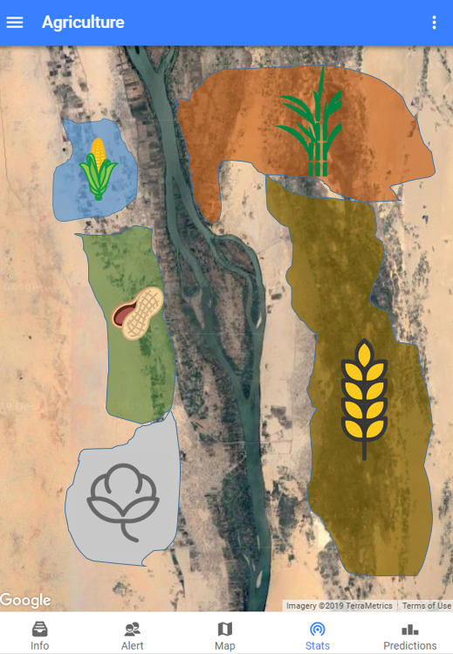

Slide 7

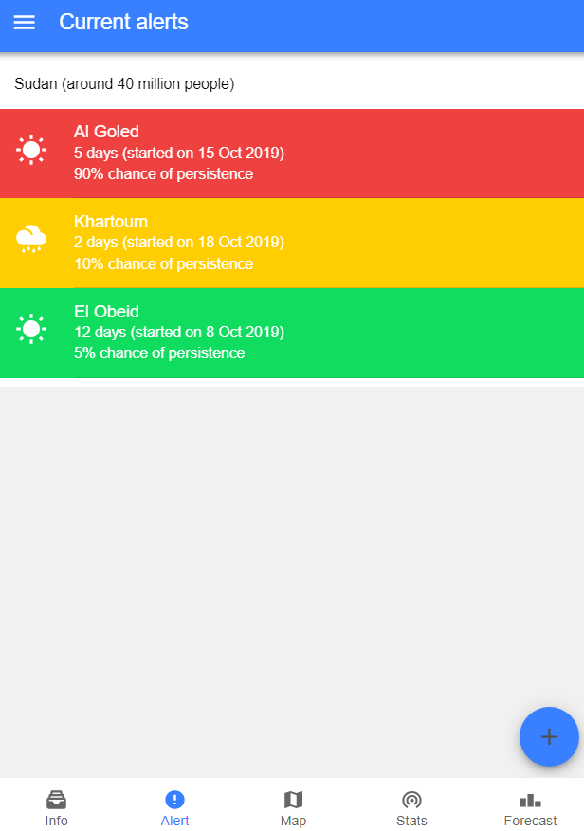

Slide 8
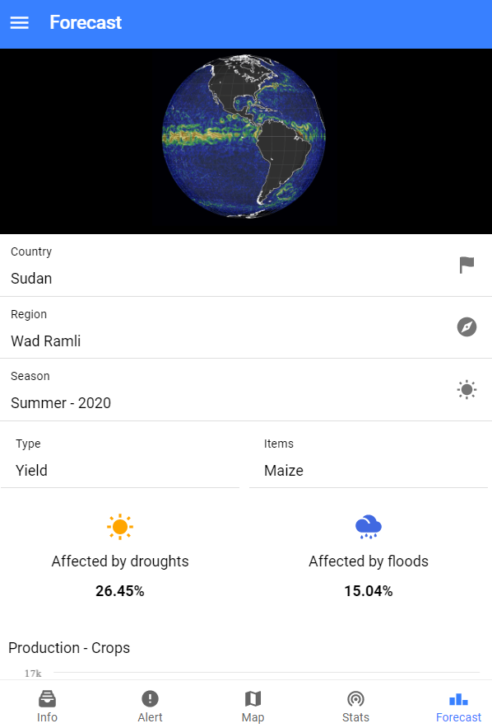
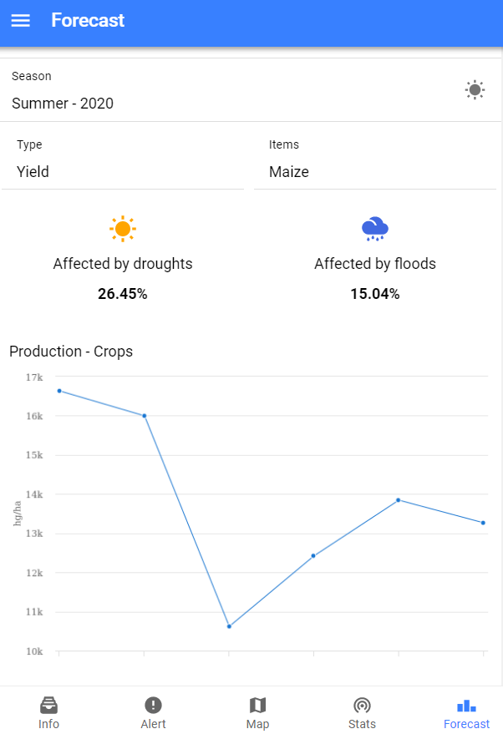

Slide 9
Business model
Government hosts and run the application
No extra taxes for the population
Companies that depend on these countries run the application
They can take action to help them improve

Slide 10
Advantages
Better water management
Increase economy locally. Government can take actions faster.
Farmers don’t have to pay
A chance for a better future for their children

Slide 11


